Slide 2
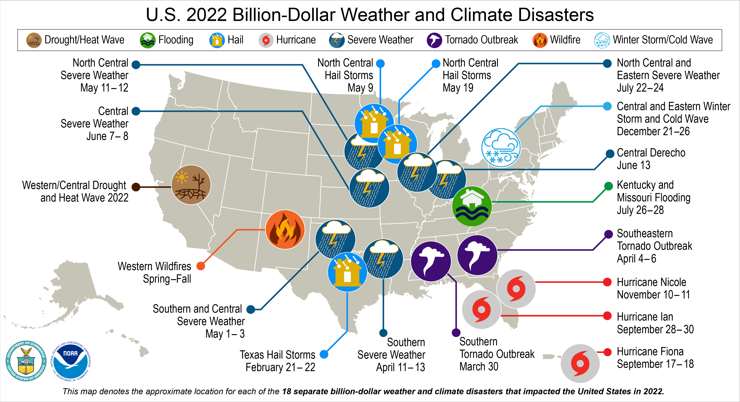
Reimagine Our Future: What this competition is all about
The Challenge:
The global sustainability crisis is an opportunity for humanity to learn to flourish without compromising the natural systems upon which we depend.
Many global sustainability challenges!
Global climate change; persistent poverty; food and water insecurity; lack of quality of education; multiple dimensions of inequities; loss of biodiversity; etc.
Your Mission:
Develop, alone or in a team, a bold and innovative plan or solution that promotes one or more of the United Nations’ Sustainable Development Goals (SDGs).
The physical and socioeconomic impacts of compound extreme events (such as simultaneous heat and drought, wildfires associated with hot and dry conditions, or flooding associated with high precipitation on top of snow or waterlogged ground) can be greater than the sum of the parts. Further, these extreme events are continuously rising. https://www.climate.gov/
SUSTAINABILITY COMPETITION
Notes:
The competition is indeed about reimagining our future.
We are all aware of many current challenges to the well-being of humans and nature.
These include the consequences of global climate change that are rapidly increasing in severity and number; continuing deaths and illnesses from COVID-19; persistent poverty and related food and water insecurity; shortfalls in access to and quality of education; multiple dimensions of inequities in our societies and economies; the global loss of biodiversity; and much more.
This competition challenges you, alone or in a team, to develop a bold and innovative plan or solution that promotes one or more of the United Nations’ Sustainable Development Goals (SDGs). In effect, you are asked to “Reimagine Our Future”.

Slide 3
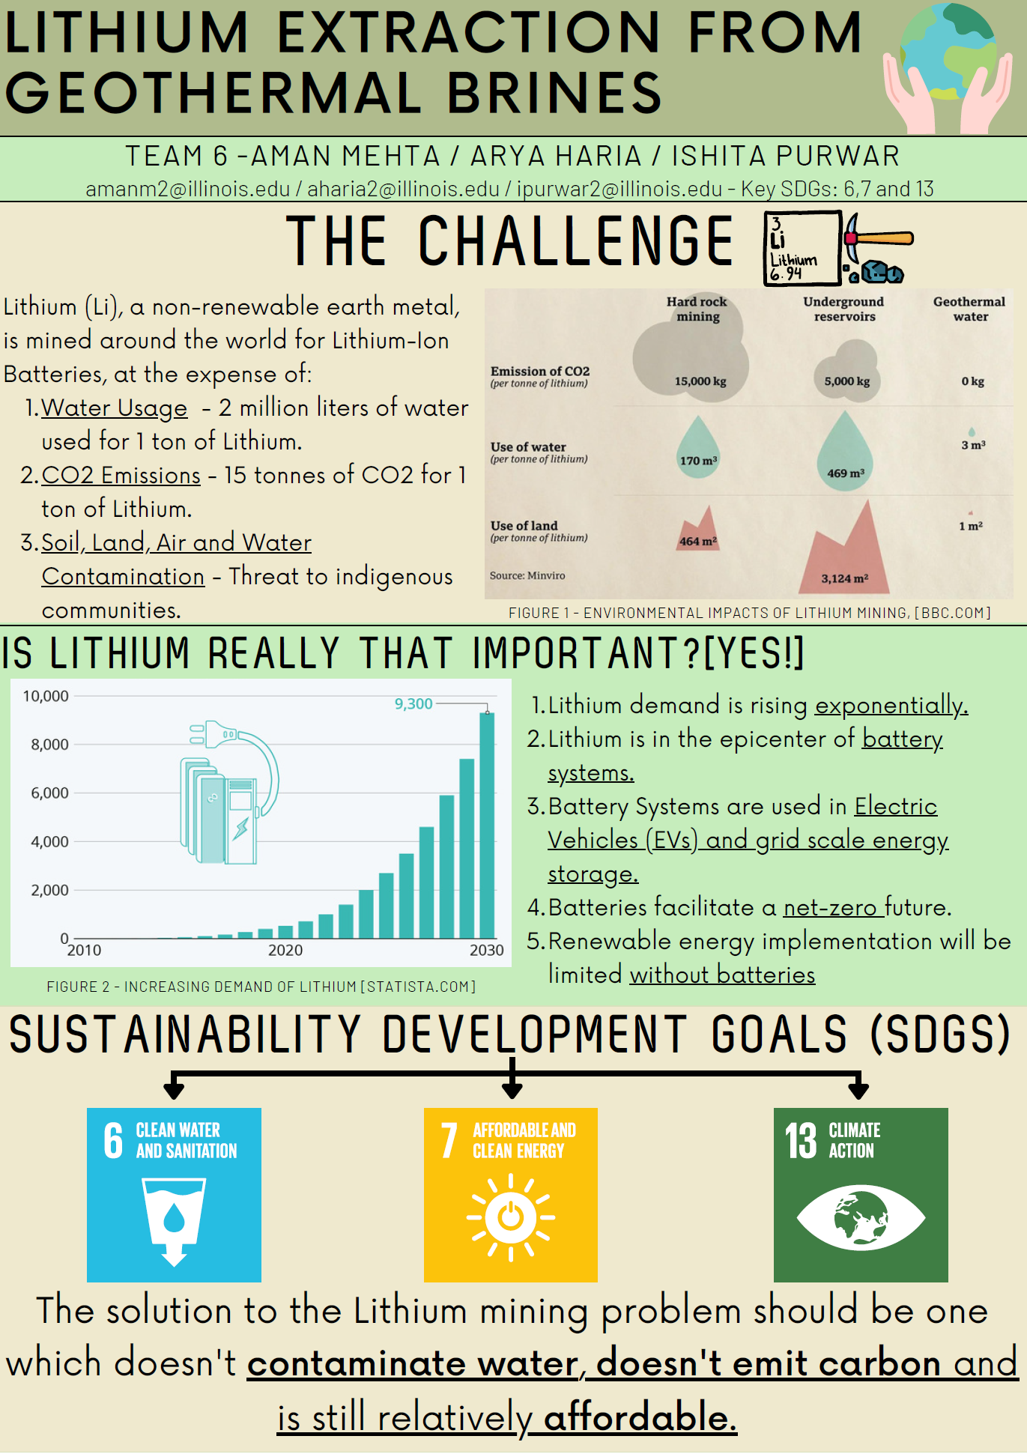
Reimagine Our Future: International dimensions of the 2022 competition
Students at Zhejiang University (third-place winner) and the University of Pretoria submitted projects in 2022.
Some 2022 submissions addressed global challenges or problems in countries other than the one in which they are studying, including Agrivoltaics in Southern Afar, Ethiopia (third-place winner), Waste Recycling in India, Lithium Extraction from Geothermal Brines (first-place winner), Phytoremediation Mats (second-place winner), and Mineral Tracking for Human Rights.
SUSTAINABILITY COMPETITION
Notes:
The competition is indeed about reimagining our future.
We are all aware of many current challenges to the well-being of humans and nature.
These include the consequences of global climate change that are rapidly increasing in severity and number; continuing deaths and illnesses from COVID-19; persistent poverty and related food and water insecurity; shortfalls in access to and quality of education; multiple dimensions of inequities in our societies and economies; the global loss of biodiversity; and much more.
This competition challenges you, alone or in a team, to develop a bold and innovative plan or solution that promotes one or more of the United Nations’ Sustainable Development Goals (SDGs). In effect, you are asked to “Reimagine Our Future”.

Slide 4
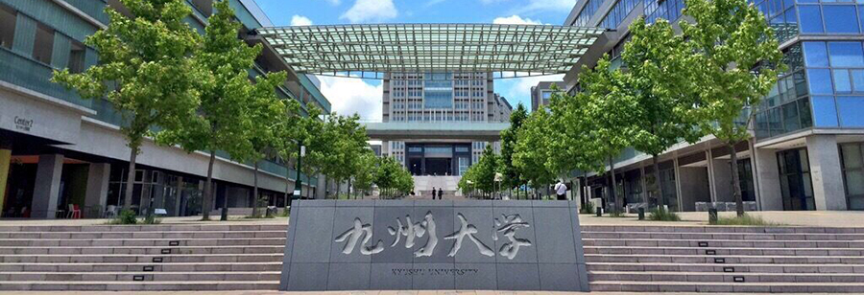
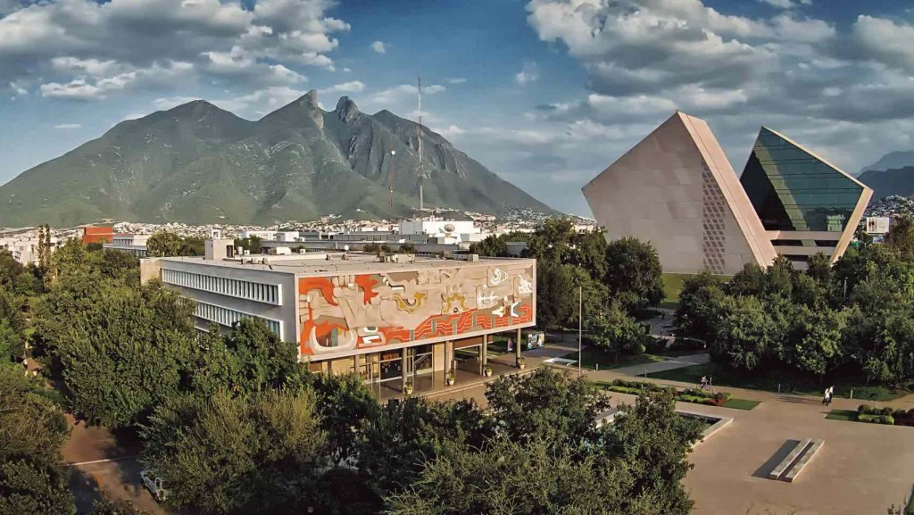
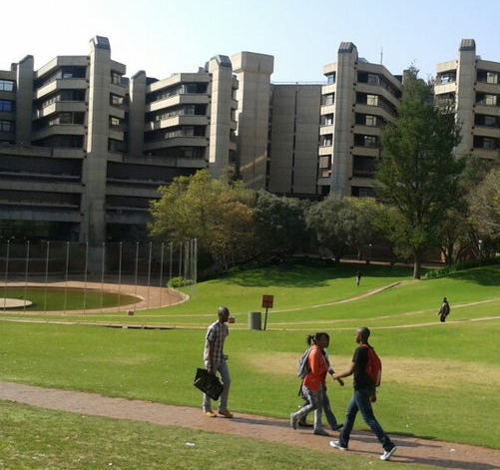
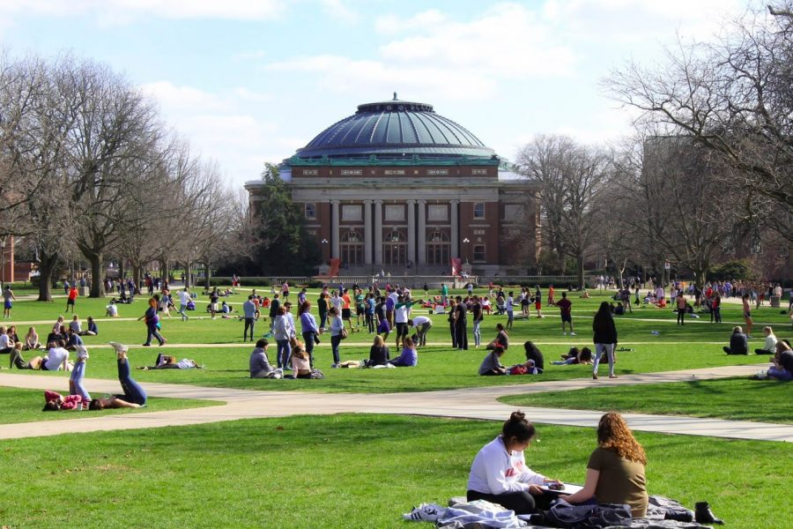
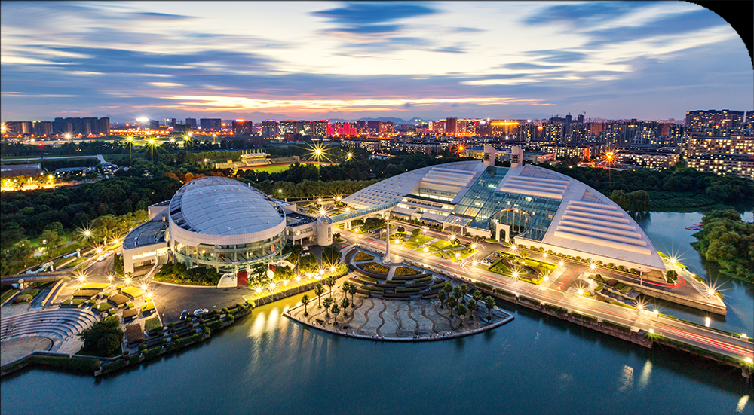
Reimagine Our Future: The 2023 competition, and beyond
Efforts are in progress aiming for students from these institutions to participate in the competition in 2023:
Birmingham University
Cambridge University
Kyushu University
Monterrey Technical University
NOVA University, Portugal
University of Illinois, Chicago
University of Illinois, Springfield
University of Illinois, Urbana-Champaign
University of Johannesburg
University of Pretoria
Vienna University of Economics and Business
Waubonsee Community College
Zhejiang University
Students may, if they wish, include in their team undergraduate students from any of these universities or from any other university in any country, including undergraduate students with whom they are acquainted through study-abroad programs
SUSTAINABILITY COMPETITION
Notes:
The competition is indeed about reimagining our future.
We are all aware of many current challenges to the well-being of humans and nature.
These include the consequences of global climate change that are rapidly increasing in severity and number; continuing deaths and illnesses from COVID-19; persistent poverty and related food and water insecurity; shortfalls in access to and quality of education; multiple dimensions of inequities in our societies and economies; the global loss of biodiversity; and much more.
This competition challenges you, alone or in a team, to develop a bold and innovative plan or solution that promotes one or more of the United Nations’ Sustainable Development Goals (SDGs). In effect, you are asked to “Reimagine Our Future”.

Slide 5
Register
Seek the Advice of Specialists
Create a Fact Sheet
Finalist Presentations
Step 1: Registration
Indicate the local or global problem you aim to contribute to solving and comment on its connections to the UN Sustainable Development Goals.
Chat with your friends and classmates about this. You are welcome to work as a team.
We can help you to form a team. Just follow the competition webpage prompts and we will try to link you with like-minded students.
Do preliminary research.
Registration opens in April and closes October 9, 2023, 11:59 p.m. (Central Time).
The United Nations 17 Sustainable Development Goals (or SDGs). https://sdg.data.gov/
https://reimagine.web.illinois.edu/registration/
SUSTAINABILITY COMPETITION
Notes:
The first step to enter the competition is to register. This is how you can go about doing that.
First, find a Sustainable Development Goal (or SDG) and a related sustainability challenge (locally or globally) that appeals to you.
Chat with your friends about this. You are welcome to work as a team.
We can help you to form a team. Just follow the competition webpage prompts and we will try to link you with like-minded students.
Do preliminary research.
Register for the competition before September 20, 2021, 10 p.m. (Central Standard Time). Follow the prompts once you access the shown web-link.

Slide 6
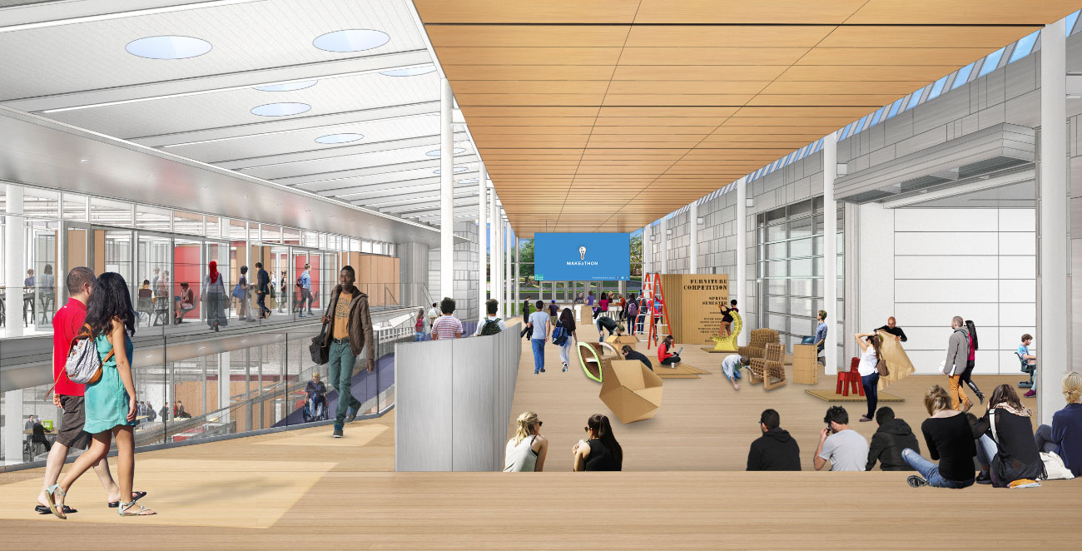
Register
Create a Fact Sheet
Seek the Advice of Specialists
Finalist Presentations
Step 2: Seek the Advice of a Specialist
Comment on social, technological, economic, environmental, and political aspects of both the problem and your solution, where relevant.
You must seek the advice of a specialist regarding your ideas. You can approach any of the +70 specialists on our webpage or you can find your own specialist: https://reimagine.web.illinois.edu/seek-the-advice-of-a-specialist/ Submit a short description of your meeting with a specialist by Oct. 15 at 11:59 p.m. (Central Time)
UIUC students can meet in the new Siebel Center for Design. The SCD staff will be on hand to assist you with your ideas. Reserve your space here: https://designcenter.illinois.edu/thecenter
The new Siebel Center for Design (SCD). As a competition entrant, you may use this beautiful space to meet with your teammates. SCD staff will be on hand to help with your ideation process.
SUSTAINABILITY COMPETITION
Notes:
Next step, seek the advice of a specialist.
Before you can approach a specialist, though, you first need to analyze the problem and your potential solution through the interrelated social, technological, economic, environmental, and political (or governance) aspects.
You must then seek the advice of a specialist regarding your ideas. You can approach any of the 50 specialists on our webpage or you can find your own specialist at the shown link. Once you have met the specialist, you must submit a short description of your meeting with a specialist by Oct. 15 at 10 p.m. (Central Standard Time) Just follow the prompts on the competition webpage.
You and your teammates are welcome to meet at the new Siebel Center for Design. The staff at the Siebel Center for Design will be on hand to assist you with your ideas. Simply pop over to the Siebel Center’s Front Desk and make an appointment or reserve desk space.

Slide 7
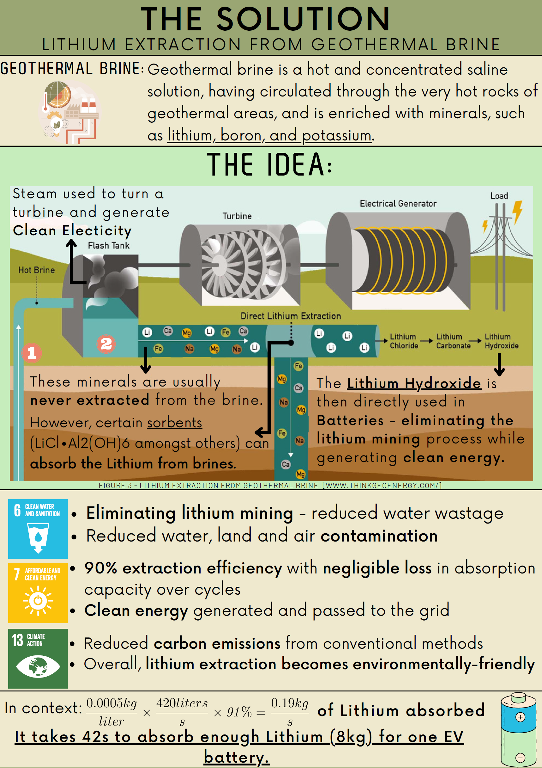
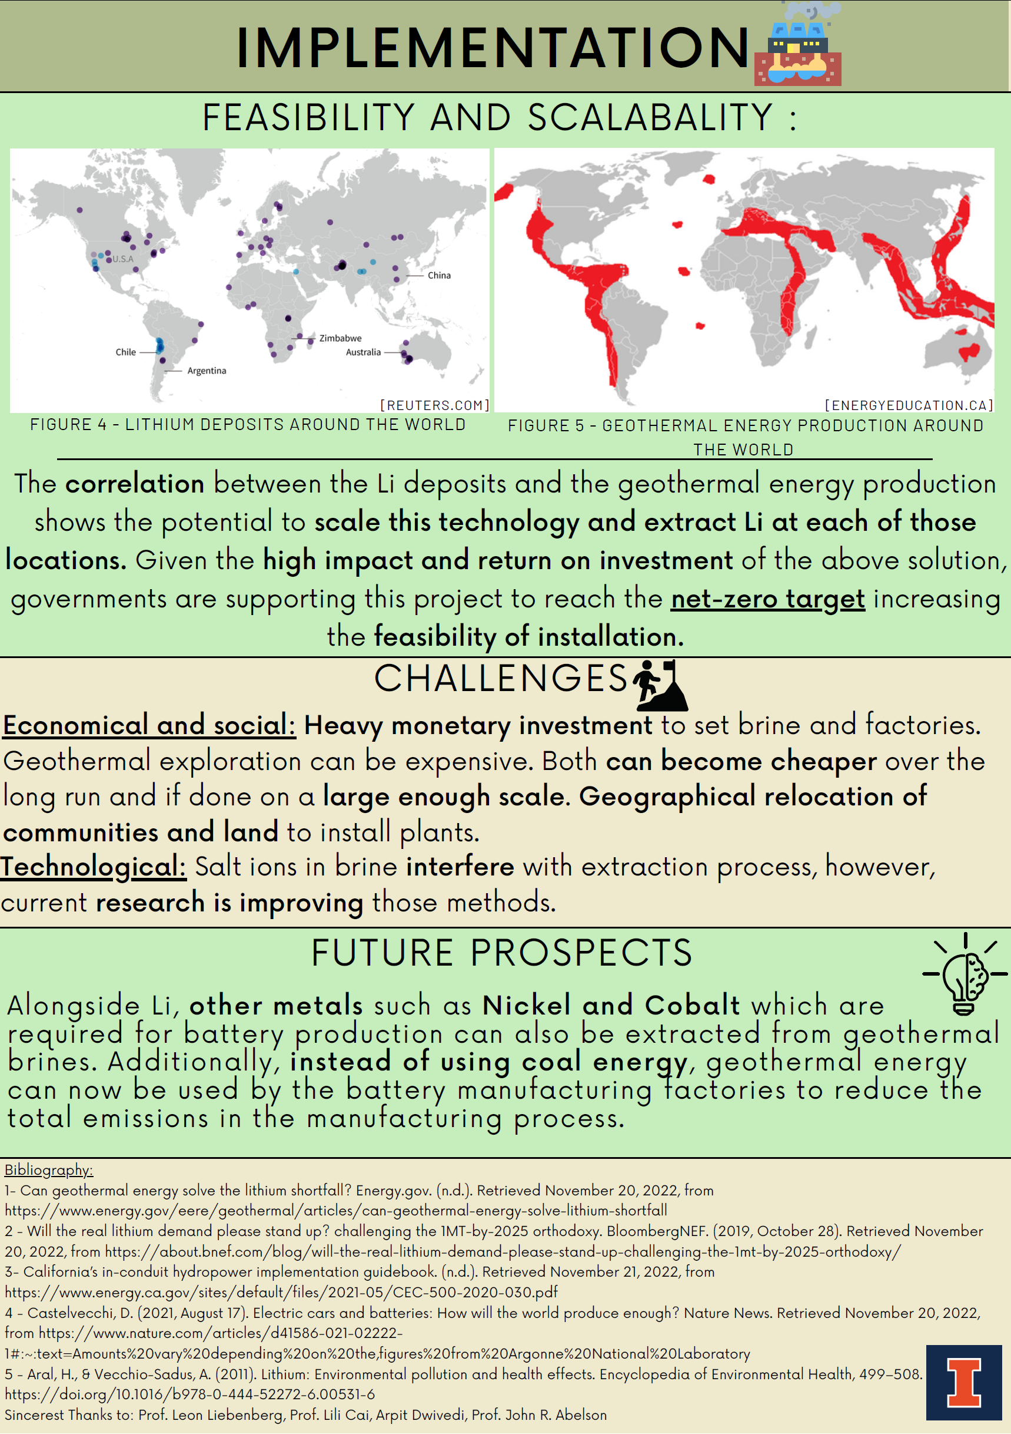
Register
Create a Fact Sheet
Seek the Advice of Specialists
Finalist Presentations
Step 3: The Fact Sheet
9. Teams must submit their ideas in a short fact sheet before Nov. 19 at 11:59 p.m. (Central Time)
A good fact sheet consists of no more than 1000 words and is typically 1 – 3 pages long: https://reimagine.web.illinois.edu/fact-sheet-requirements/
All excellent fact sheets will be widely publicized after the competition.
Fact Sheet. Your idea/s or solution must be submitted in the form of a fact sheet that summarizes all your salient thoughts.
SUSTAINABILITY COMPETITION
Notes:
With the competition’s third step, you must submit a short fact sheet.
8. Your fact sheet is due by Nov. 22 at 10 p.m. (Central Standard Time).
9. A good fact sheet consists of no more than 1000 words and is typically 1 – 3 pages long. The detailed requirements for a fact sheet are available at the shown weblink. You will also find lots of tips there to help you produce a high-impact fact sheet. We also provide a sample of what an excellent fact sheet might look like.
We will publicize all excellent fact sheets in a number of media outlets.

Slide 8
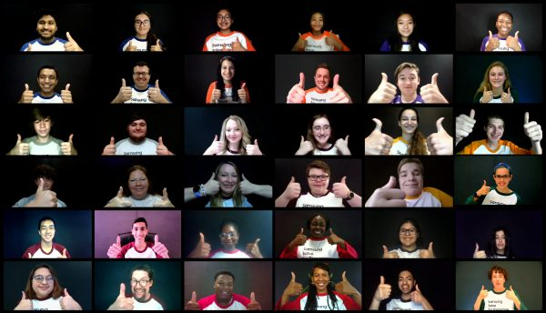
Register
Create a Fact Sheet
Seek the Advice of Specialists
Finalist Presentations
Step 4: Finalist Presentations
A team of judges will assess your entry and select 6 to 10 finalists (announced Nov. 25).
The 6 to 10 finalists will present their projects at an award ceremony on Dec. 2, 2023. Some contestants will meet in-person, and the event will be streamed on Zoom.
A team of prestigious judges will select the top three winners and announce the winners at this award ceremony.
The first, second, and third prizes are $2000, two $1000 awards, and three $500 awards, respectively. There are also $500 awards for winners of special categories.
Every effort will be made to link winning teams with individuals or organizations who will help them to further develop and implement their ideas.
Winning entries will be widely publicized.
Winners will be announced on December 2, 2023. This will be a hybrid event with some contestants meeting in-person and others via Zoom.
SUSTAINABILITY COMPETITION
Notes:
Finally, a team of judges will assess your entry and select 6 to 10 finalist. The finalists will be announced on November 26.
The finalists will be asked to produce a 6-minute video that captures the essence of their idea (or ideas) or solution. Videos must be uploaded on the competition webpage by Nov. 30. Just follow the prompts on the competition webpage for preparing and submitting your video.
The finalists’ videos will be screened at the prestigious World Sustainability Teach-in Day, where tens of thousands of students from around the world will showcase their sustainability projects. You can view more details about this event at the shown website.
The six to 10 finalists’ presentations will also be placed on social media where all UIUC students will get one opportunity to vote for their favorite project. The judges will not have access to this popular vote. We will however announce the popular vote winner on December 4.

